Slide 1
DearSurvival
CaiO. Sungsoo Park
Deargen Inc.

Slide 2
Survival Analysis
Survival Time
Usually Continuous
Always >= 0
Incompletely observed responses are censored

Slide 3
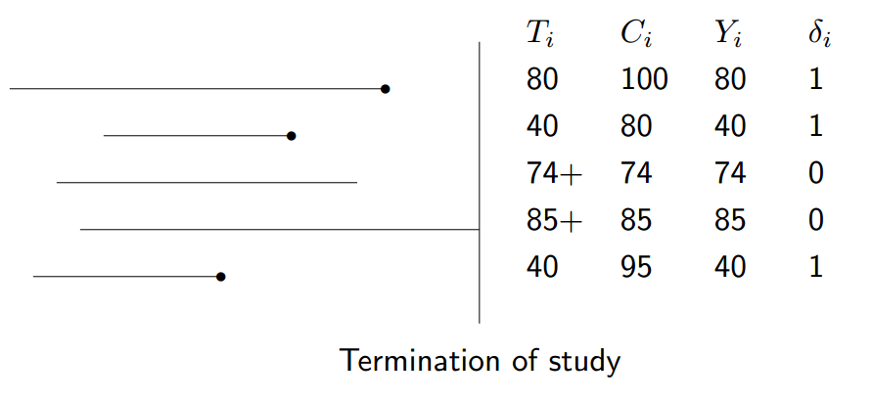
Survival Analysis
Censoring
Censoring is present when we have some information about a subject’s event time, but we don’t know the exact event time.
right-censoring
A subject does not experience the event before the study ends
A person is lost to follow-up during the study period
A person withdraws from the study
Right-censored
Start observation
Event
* We assume that sample aquisition happened at diagnosis in TCGA data

Slide 4
Survival Analysis
Censoring
- If one opts to use standard regression methods, the right-censored data is
considered to be a type of missing data.
-This is typically discarded which can introduce a bias in the model.
-Therefore, modeling right-censored data requires special consideration or the use of a survival model.

Slide 5
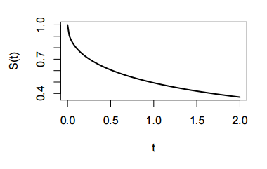
Survival Analysis
Survival Function
“the probability of survival at least until time t.”
• T denotes the response variable, T ≥ 0.
• The survival function is S(t) = P r(T > t) = 1 − F(t).

Slide 6
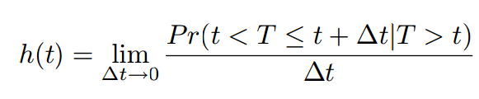

Survival Analysis
Hazard Function
“the instantaneous rate of failure at time”
Hazard function
Cumulative Hazard function

Slide 7
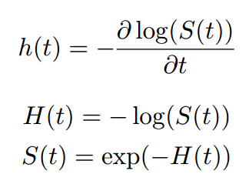
Survival Analysis
relations

Slide 8


Survival Analysis
Standard statistical methods for survival analysis
-> Cox Regression Model
The hazard function
The baseline hazard function
Variable/covariates. Age, sex, tumor size etc.
The coefficients for each covariate
Cox model is mainly used to study the importance of covariates for survival but seldom used to estimate survival times.
To predict survival for new case the value of coefficient have to be estimated
Also the baseline hazard function has to be computed. (non-trivial task)

Slide 9
Survival Analysis
Neural Networks in survival analysis – study
Classification method
Classification good vs poor survival
“A neural Network Model for prognostic prediction”, W.Nick Street 1998
Time encoded method
Time data is used as input data
“Artificial neural networks and prognosis in medicine. Survival analysis in breast cancer patients”, Franco 2005
Faraggi-Simon network
Estimate an individual’s risk of death. => produce Survival Function
“A neural network model for survival data”, Faraggi and simon 1995
“Deep Survival: A Deep Cox Proportional Hazards Network”
, Katzman 2016

Slide 10
Survival Analysis
Neural Networks in survival analysis – time encoded model
Input Layer
hidden Layer
output Layer
Age
Tumor size
0 ~ 1 probability
.
.
Time group 1
Time group 2
.
.
.
.
Time group 1
Time group N
Time group 2
.
.
Time group N

Slide 11
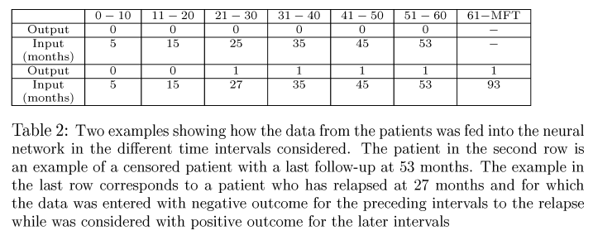
Survival Analysis
Neural Networks in survival analysis – time encoded model

Slide 12
Survival Analysis
Neural Networks in survival analysis – time encoded model
Advantage
network input에 time값을 넣어서, covariates가 time dependent하게 만들 수 있음
The effect of covariates의 non-linearity를 학습 할 수 있음
Do not need a baseline hazard function (quite flexible)
disadvantage
Outcome과 variable간의 정확한 관계를 파악하기 어려움
Black-box

Slide 13
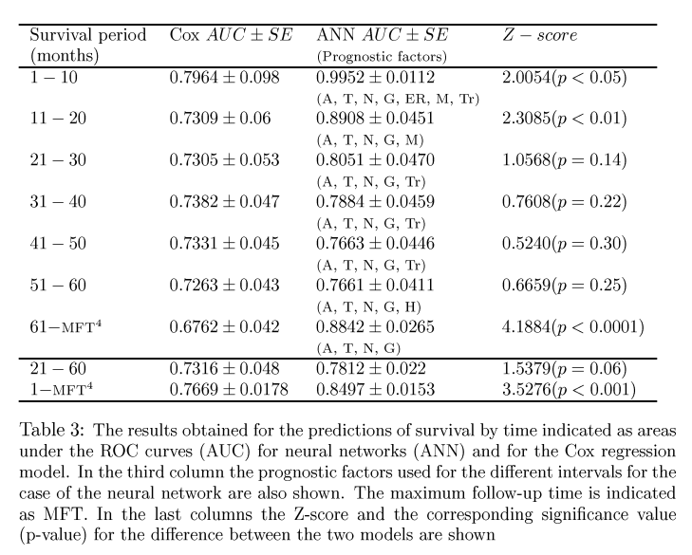
Survival Analysis
Survival model Comparison – time encoded model

Slide 14
Survival Analysis
Survival model Comparison
General binary discrimination model evaluation => area under ROC curve
+ continuous survival time
+ event-censor data
Concordance Index

Slide 15
Survival Analysis
Concordance index
X : Actual survival time
T : Predicted survival time
Any two subjects are concordant if:
Xi > Xj and Ti > Tj
Xi < Xj and Ti < Tj
Concordance score
Xi > Xj and Ti > Tj => +1
Xi > Xj and Ti == Tj => +0.5
Xi > Xj and Ti < Tj => +0
c-index 계산
comparable concordance score / all comparable pairs
Comparable
1. Two subjects without events are not comparable
2. Event vs Event comparisons are comparable
3. Event vs non-event comparisons are comparable

Slide 16
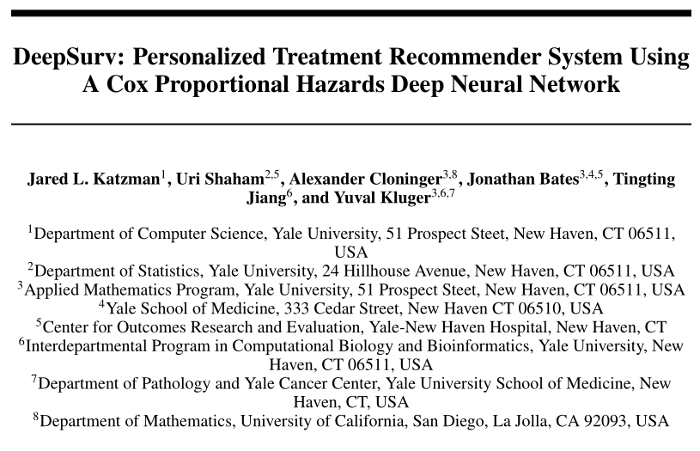
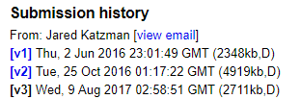
Survival Analysis
Deep Surv
[V3]에서 추가됨

Slide 17
Survival Analysis
Deep Surv - introduction
- One standard survival model is the Cox proportional hazards model
- The model assumes that a patient’s risk of failure is a linear combination
of the patient’s covariates.
- However, in many applications, such as providing personalized treatment recommendations, it may be too simplistic to assume that the risk function is linear.
- As such, a richer family of survival models is needed to better fit survival data with nonlinear risk functions

Slide 18
Survival Analysis
Deep Surv - introduction
- researchers have attempted to apply the Faraggi-Simon network with various extensions,
but they have failed to demonstrate improvements beyond the linear Cox model
- One possible explanation is that the practice of NNs was not as developed as it is today. To
the best of our knowledge, NNs have not outperformed standard methods for survival analysis (e.g. CPH)

Slide 19
Survival Analysis
Deep Surv - Background
Needs Non-linear model
The Faraggi-Simon method is a feed-forward neural network that provides the basis for a nonlinear proportional hazards model.
the Faraggi-Simon network has not been shown to outperform the
linear CPH. we were the first to attempt applying modern deep learning techniques to the Cox proportional hazards loss function
Another popular machine learning approach to modeling patients’ risk function is the random sur-vival forest (RSF). The random survival forest is a tree method that produces an ensemble estimate for the cumulative hazard function.

Slide 20


Survival Analysis
Deep Surv - Background
CPH linear survival model
estimates the risk function h(x) by a linear function
T i : event time
E i : event indicator
x i : baseline data for the i th observation
The partial likelihood is the product of the probability at each event time T i that the
event has occurred to individual i, given the set of individuals still at risk at time T i . The Cox partial likelihood is parameterized by β and defined as
The product is defined over the set of patients with an observable event E i = 1.
The risk set <(t) = {i : T i ≥ t} is the set of patients still at risk of failure at time t

Slide 21
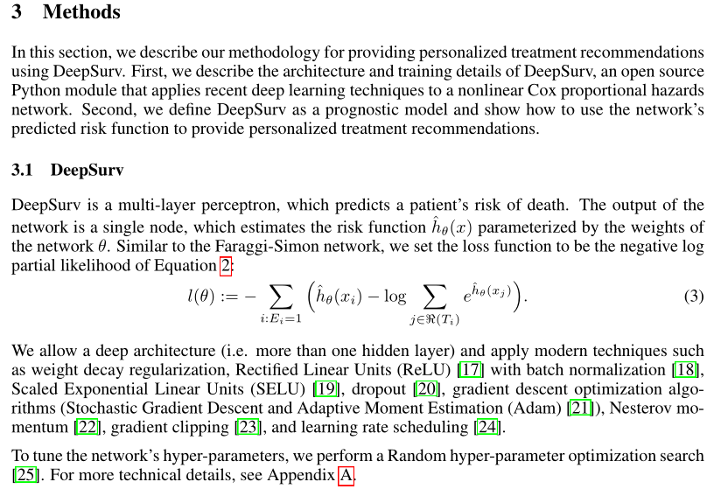
Survival Analysis
Deep Surv - Method
https://github.com/jaredleekatzman/DeepSurv

Slide 22
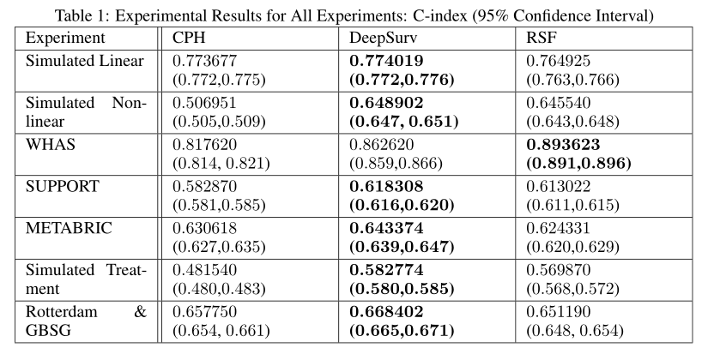
Survival Analysis
Deep Surv - Result
Worcester Heart Attack Study (WHAS) : 1,638 observations and 5 features
Study to Understand Prognoses Preferences Outcomes and Risks of Treatment
(SUPPORT)
9,105 patients and 14 features
Molecular Taxonomy of Breast Cancer International Consortium (METABRIC)
4 gene indicators(MKI67, EGFR,PGR, andERBB2)with the a patient’s clinical features
(hormonetreatmentindicator, radiotherapyindicator, chemotherapyindicator, ER-positiveindicator,
age at diagnosis)
1,980patients

Slide 23
Survival Analysis
A little experiment.
DATA
https://github.com/deargen/wx-survival
Ref code.
https://github.com/jaredleekatzman/DeepSurv
https://github.com/mexchy1000/DeepSurv_Keras
Setting
SLP( no hidden layer )
No preprocess (without data normalization / standardization)
No postprocess (use raw survival days)
RMSE loss function VS Negative log likelyhood loss function

Slide 24
Survival Analysis
A little experiment.
Check the code.
c_index = cindex(s_tst, c_tst, Y_pred) #our function
c_index_lifeline = concordance_index(s_tst, Y_pred, c_tst_reverse) #package
Def cindex(...):
.
.
.
c = c*1.0 / N_valid_sample
return c#1-c ??

Slide 25

Survival Analysis
A little experiment.
Loss function
def negative_log_likelihood(E, NUM_E):
def loss(y_true,y_pred):
hazard_ratio = K.exp(y_pred)
log_risk = K.log(K.cumsum(hazard_ratio))
uncensored_likelihood = K.transpose(y_pred) - log_risk
censored_likelihood = uncensored_likelihood * E
neg_likelihood = -K.sum(censored_likelihood)/NUM_E
return neg_likelihood
return loss
Label values have to be sorted
Batch_size = whole samples
No shuffle at training

Slide 26
Survival Analysis
A little experiment.
Result – mRNA only
LUAD
LUSC
Model | Loss fucntion | Test C-index (mean of 5 times )
SLP | RMSE(ALL) | 0.5939
SLP | RMSE(Uncensor) | 0.6282
SLP | NLLH | 0.6092
MLP (DeepSurv) | NLLH | 0.4396
Model | Loss fucntion | Test C-index (mean of 5 times )
SLP | RMSE | 0.5170
SLP | RMSE(Uncensor) | 0.5676
SLP | NLLH | 0.5724
MLP (DeepSurv) | NLLH | 0.5287
GBMLGG
BRCA
Model | Loss fucntion | Test C-index (mean of 5 times )
SLP | RMSE | 0.6794
SLP | RMSE(Uncensor) | 0.8015
SLP | NLLH | 0.8185
MLP (DeepSurv) | NLLH | 0.6740
Model | Loss fucntion | Test C-index (mean of 5 times )
SLP | RMSE | 0.4696
SLP | RMSE(Uncensor) | 0.6294
SLP | NLLH | 0.7347
MLP (DeepSurv) | NLLH | 0.5470
RMSE 모든 데이터 사용시 가끔 loss가 inf로 감 , Uncensor 데이터만 사용시 그런 현상 없음
MLP DeepSurv는 Input data 정규화 후 수행함
CPH(Cox’s Proportional Hazard model)은 Running중.. 언제끝날지?(피쳐수가 많아지면 급격하게 느림)

